Slide 1

Data state of mind
MaryJo Webster CAR Editor maryjo.webster@startribune.com @MaryJoWebster

Slide 2

Data is a source
Notes:
The #1 thing to take away from this session is that you should be treating data the same way you treat human sources.

Slide 3
Same sourcing rules apply...
Is this source reliable? And how do you know that?
What can and can’t this source tell us?
Verify what this source tells you
Make sure you use more than one source
Notes:
Ask the same questions you would when they have a new source
especially – is this source reliable? and how do you know that?

Slide 4

If you ask wrong question, you’ll get wrong answer
Notes:
When talking to humans, you might get a wrong answer if you phrase your question in a way that they don’t quite understand. Data works the same way – the difference is that you are asking your question in “computer speak”, so it’s much easier for us to trip up – since that’s not our native tongue. To get around this, it’s a really good idea to ask lots and lots of questions – framed in different ways. Luckily, data will sit and answer questions for hours and hours on end, without getting annoyed by you.

Slide 5
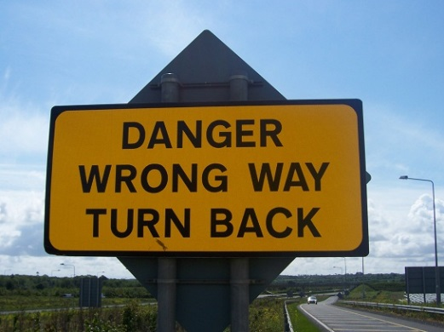
If something doesn’t seem quite right, check it out
Notes:
As with human sources ,we sometimes get led to believe something might be true, but our gut says maybe it’s not.
There are all kinds of ways your analysis results can end up with big outliers or unusual results – and the majority of the time it’s either the result of faulty data to begin with or some error in the analysis. But we can prevent publishing something incorrect or out of context by following the same rules we use with human sources --- checking our results against other sources and looking for ways to disprove the results.

Slide 6

Data can only tell you what it knows
Notes:
Like people, we have to approach data analysis with the understanding that the only answers we’re going to get are ones that the data has the “knowledge” to answer. If something is not in the data you request, you might not be able to get the answer you want.
Several years ago, a reporter at the PiPress asked for data on foster care homes that had had their licenses suspended or revoked. She asked that the data include the reason the license was pulled. DHS kind of freaked out on us. We got their data people to have a phone conference with us and then they explained that their database doesn’t include the reason – that information only existed in their paper records. The database was essentially an index of their paper records.

Slide 7

It will often lead you to more questions…
Notes:
The analysis and reporting phase of the story should be one –going back and forth between data and human sources. Oftentimes, the humans will lead you to something in the data that you hadn’t thought to look for before.

Slide 8

But shoe-leather reporting
is as important as ever…
Data should not be your only source
Notes:
There are people who will know the topic or the particular dataset better than we do and it’s crucial that we get their feedback on our analysis. If they question our analysis, even slightly, it’s important to go back and review our work, if not re-do it altogether.

Slide 9
What is “data”?
Notes:
Before we get too much farther, I’d like to take some time to just talk about what I mean when I use the word “data.”

Slide 10
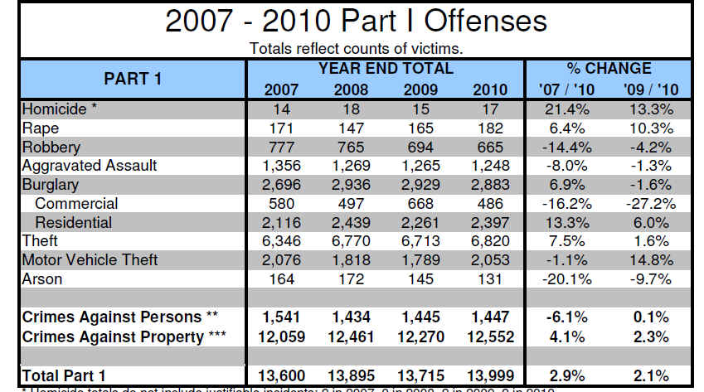
Aggregate
or
Summary
Notes:
We’re all very accustomed to data like this – a summary or aggregate. Officially, though, this is “information” that was generated from data.
Still there are times when we can only get aggregate or summary information– data from schools is one of the best examples. We can’t get records showing how each student did on their standardized tests, but we can get an aggregate for groups of students (all black students in one grade in one school, for example).

Slide 11
Questions we can ask the aggregate data?
Which crime(s) had biggest increase or decrease across the three years
Compare property crime to crimes against persons
Notes:
The questions that you can ask aggregate data will be restricted by the amount of information you’re provided.
This police data is very limited. In fact, the answers to our questions are already there – we don’t need to do any of our own analysis (although we might want to check their math)

Slide 12
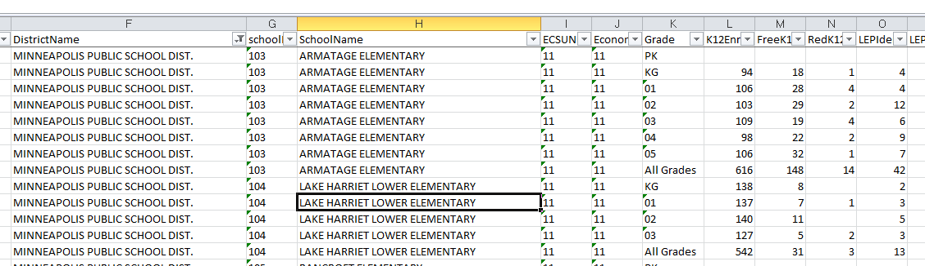
Notes:
But aggregate data that is more complex – such as this one – offers more opportunity for questions.
This is enrollment data – by “special populations” – for all schools in the state. I’ve zoomed in on some Minneapolis schools. You’ll see that there is one record for each grade, plus a record that combines all grades. Then it shows the number of students on free lunch, reduced price lunch, limited English proficiency, special education, etc. We could use this data to find which schools have the highest concentration of poor students. Or we can get multiple years of this same data and see which schools have had the greatest increase or decrease.
Or we could do this same analysis but at the district level, rather than school level.

Slide 13
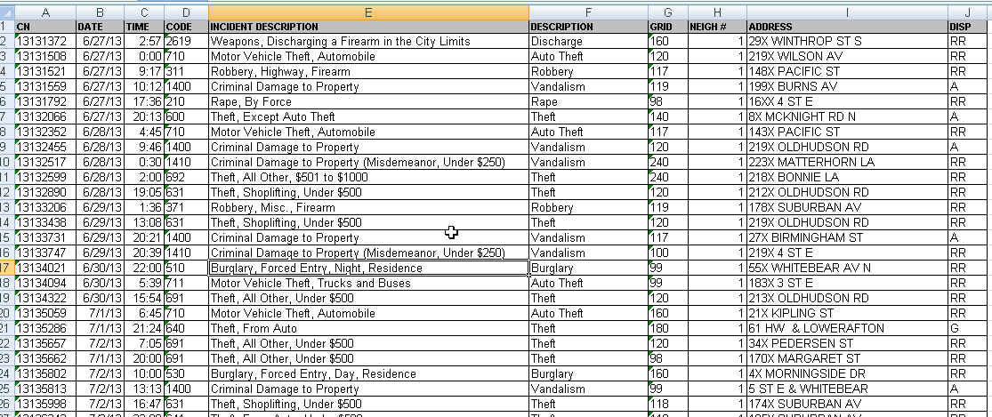
Raw data
Notes:
But in situations where we are not restricted by privacy laws, we should always try to get as detailed data as we can – this is what is called “raw data.”
Raw data is what is used to generate those summary charts, like the police UCR report one we just looked at.
This is from the St. Paul police and shows one record for each incident. It shows where it occurred by an address, the neighborhood and the police district; It has the date and time it was reported, the type of incident and whether it resulted in a report.

Slide 14
Questions for the raw data?
Which neighborhood had biggest increase in crime?
Were some parts of the city more prone to certain types of crimes than other neighborhoods?
Is there a time of day or day of week when more crimes are reported?
Per capita crime rates
You can turn this into a map!
Find crime reports at particular addresses
Notes:
So now we have lots of questions we can ask. Not only can we generate the same kind of summary report, but we can go off in other directions.
We could match this data up to another dataset that has addresses for all the schools in the city and see how often reports are taken there.
We can compare neighborhoods -- is gun violence increasing faster in one neighborhood than another?
We can look at more detail – instead of just knowing that there were 6800-ish thefts in 2010, we can see what kinds of thefts (items from cars? shoplifting? etc) and where it’s occurring most.

Slide 15
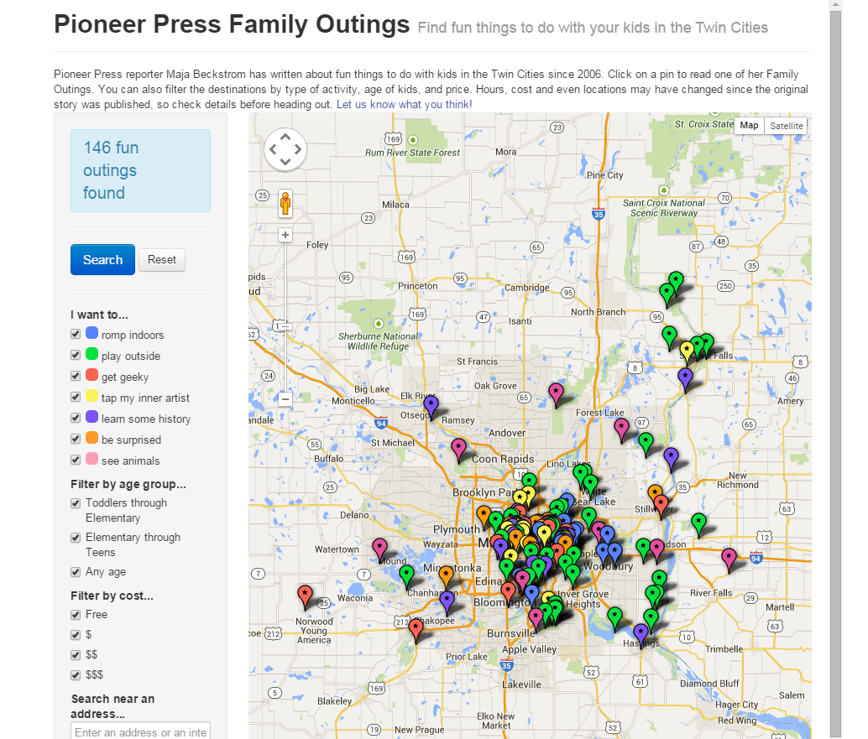
Anything can become data.....
Notes:
You can turn just about anything into data. At the Pioneer Press, we built a database of stories that the Family reporter had written and then turned it into an interactive map that parents could use to find cool things to do with their kids.

Slide 16
NY Times reporter Derek Willis – database of congressional press releases
search for “Ebola” in title
January-June, 2014 | 0
July | 2
August | 8
September | 56
October | 275
Notes:
“Data” doesn’t have to start out in rows and columns. NY Times reporter Derek Willis keeps a database of every congressional press release (he scrapes them from the Web) and then he can tap it for various things now and then. Last year as the Ebola crisis was hot news, he wondered what the press releases had to say about Ebola....and his data showed that the discussion among the Congressmen had heated up at pretty much the same pace as the news coverage.

Slide 17
Examples of what you can do with a data state of mind

Slide 18
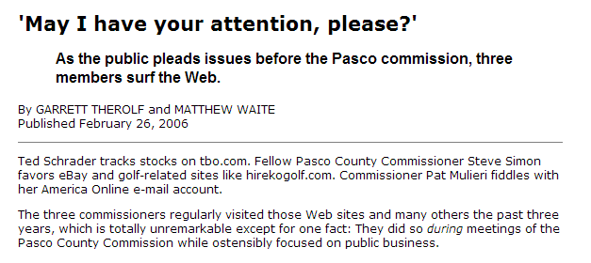

Data: Internet history for all county employees
Notes:
This is one of my favorite examples. Reporters at the St. Petersburg Times were wondering what the Pasco County Commissioners were doing during commission meetings. All of them had their heads down, consumed by their laptops. By asking a few questions, the reporters found out that those computers were connected to the county’s network. And the county kept Internet history logs, specific to each user. And yes, those were public records. So the reporters requested the history logs, filtered it down to the commissioners’ user IDs, then filtered it down to the days and times when meetings occurred. Then they looked at which sites the commissioners were visiting and wrote this great – yet rather simple – story telling the readers which sites those commissioners were visiting. And readers could quickly ascertain that it sure didn’t seem like official govt business.

Slide 19
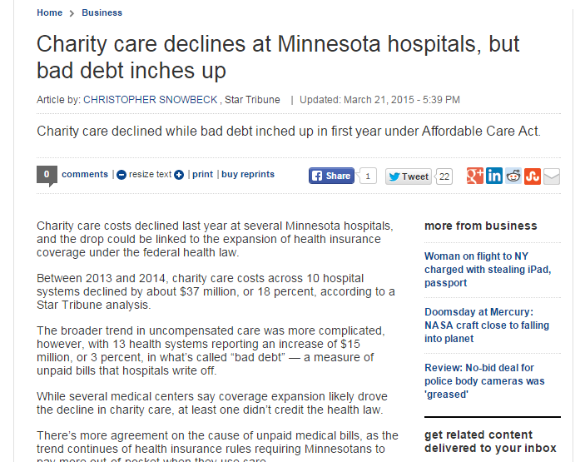
Snowbeck has his own database where he stores various information on MN hospitals, including charity care, profitability, ER usage, surgeries and other details.
Notes:
Another way beat reporters can put data to use on their beats is to build their own databases – it guarantees you’ll have unique stories.
Chris Snowbeck keeps his own database with various info on Minnesota’s hospitals, including charity care, profitability, ER usage, surgeries and other details.
He tapped his database for this story on how charity care has declined.

Slide 20
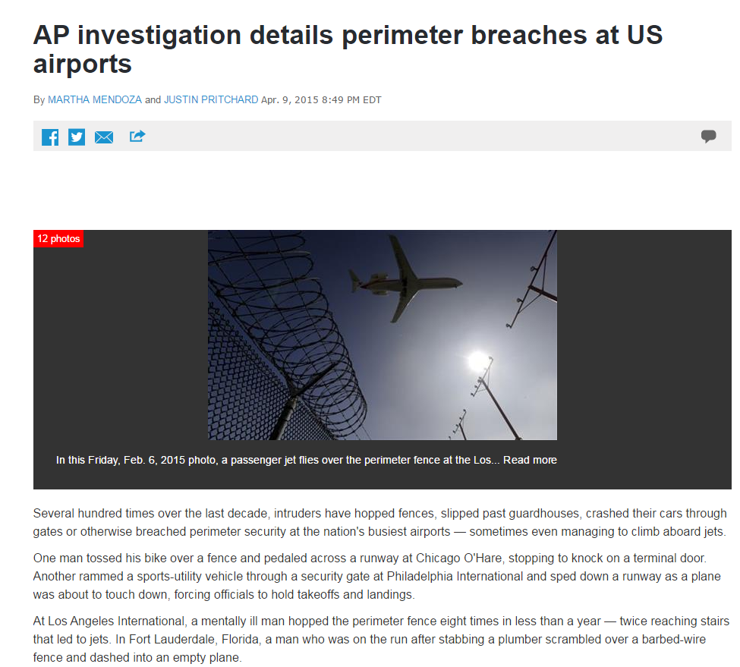
Q: How often do perimeter breaches occur at airports?
Notes:
The AP's analysis was prompted by a high-profile breach last spring that resulted in one 15-year-old's improbable journey to Hawaii. Yahya Abdi climbed a fence at San Jose International Airport, hoisted himself into a jet's wheel well and survived an almost six-hour flight. Abdi, who lived with his father and stepmother, said he was trying to get back to his mother, a refugee in Ethiopia.
Afterward, San Jose airport spokeswoman Rosemary Barnes said breaches are more common than people realize.
Through public records requests, news archive searches and interviews, the AP created the most comprehensive public accounting of perimeter security breaches from January 2004 through January 2015 at San Jose and the nation's 30 busiest airports. The analysis excluded incidents inside the airport, such as when a passenger went unscreened through a security checkpoint or walked out the wrong exit door.

Slide 21
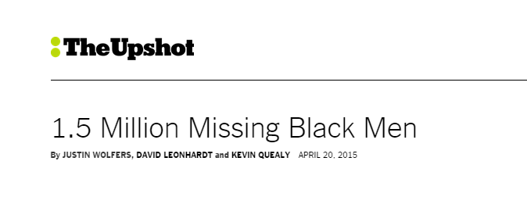
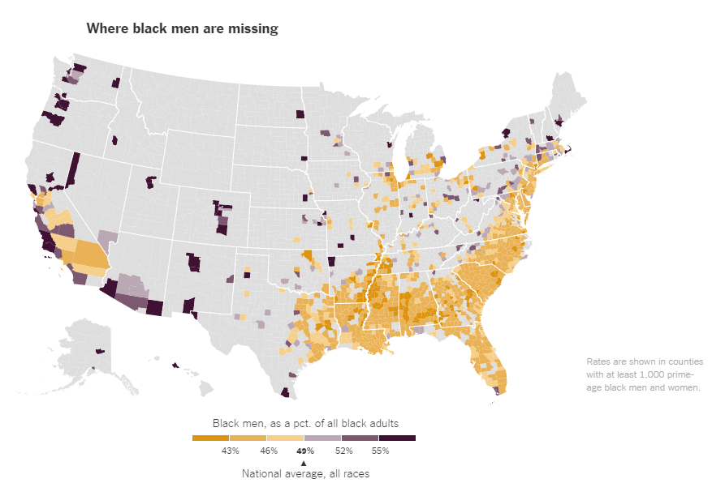
Q: Can we measure the much-discussed topic of prime-age black men missing from society?
Notes:
Upshot used 2010 Census data to analyze one of the key underlying issues that affects so many other things in the black community – the “missing” black men. The piece starts with the assumption that in any given place men should make up roughly half of the regular “prime age” population (excluding those in prison or in the military). Same should hold true when you zoom in on a specific racial group. But their analysis found that this doesn’t hold true for the black population. There are about 1.5 million FEWER black men than women in the “prime” age group of 25 to 54. And they found places – such as Fergusen, Mo – where this gap was particularly stark.

Slide 22
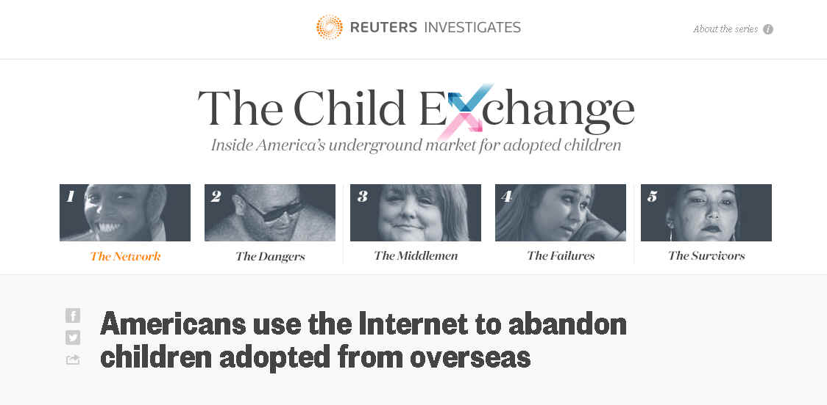
Q: Can we “track” the buying and selling of foreign adoptees in online discussion boards?
Notes:
This is one of the more interesting uses of data analysis that I’ve seen. The story uncovers an online network where foreign-born adoptees are bought and sold. To really understand the network, Reuters scraped messages from various discussion boards and turned that into a database. That enabled them to find numerous postings where it was clear the same child was being sold for a second or third time. It made for a very powerful story, combined with impressive shoe-leather reporting that included amazing interviews with some of the buyers and sellers.

Slide 23
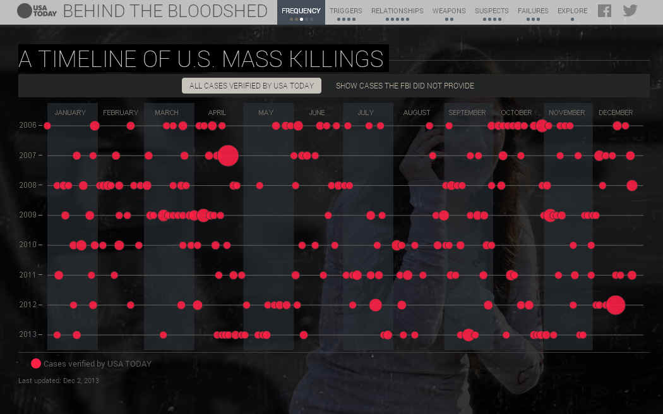

Q: How often do mass killings occur?
Data:
FBI data
Media reports
Local police records
Notes:
Data is frequently used for putting big events into context. This USA Today project, “Behind the Bloodshed” sought to answer the question – “How often do mass killings occur?”
The answer: more often than you’d expect based on the news.
They built this database, starting with incomplete FBI data and then adding other incidents based on news stories and local police reports.

Slide 24
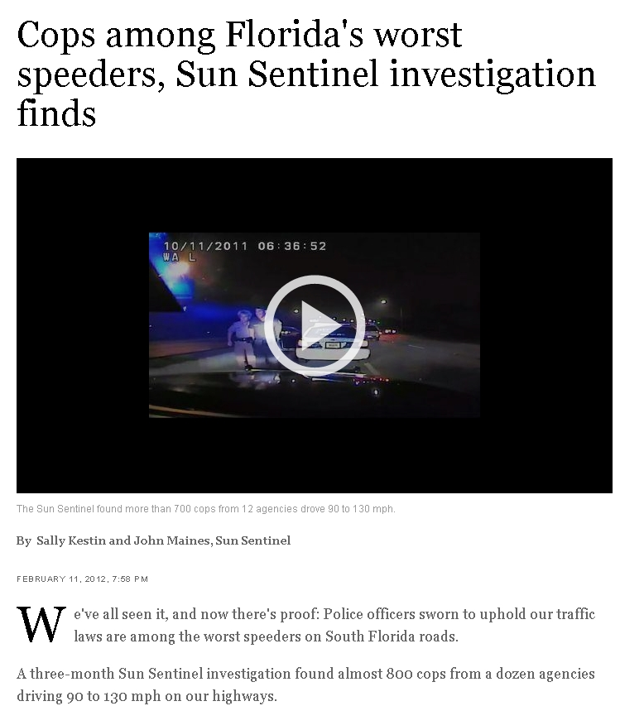
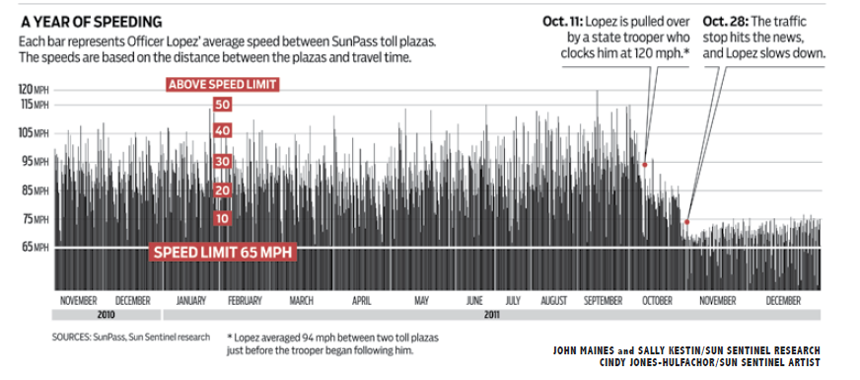
Q: How often are off-duty cops speeding in their cruisers?
Notes:
This is one of several recent Pulitzer Prize public service award winners that relied heavily on data. For this one, the reporters were trying to find out how common it was for off-duty police officers drive well over the speed limit, coming and going to work. It stemmed from a traffic stop where an off-duty Miami officer was clocked going in excess of 120 mph. At first, they thought they might be able to get data from GPS devices in the police cruisers. Agencies either didn’t use them or put up a fight for the data. Then they realized the Florida toll system records the date, location and time down to the hundredth of a second when a car passes through a toll booth. They used a portable GPS device to measure the distance between each toll booth– logging more than 2,500 miles over three counties. They also analyzed crash data to find instances of speeding cops involved in accidents.

Slide 25
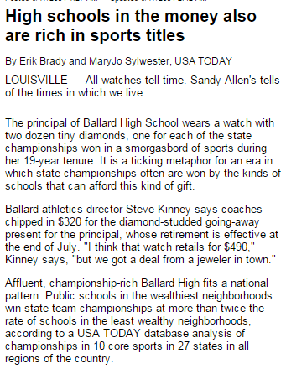
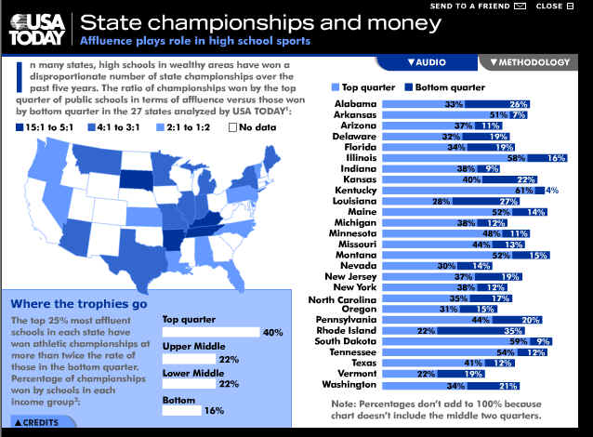
Q: Do “rich” high schools win more state championships?
Notes:
We started with a common question (or perhaps assumption) – Do “rich” high schools win more sports titles than those in lower-income neighborhoods?
The trick was figuring out how to measure that. Cause it’s not something that someone keeps track of. There wasn’t a single database out there that would answer this question.
So we built our own. Since this was such a large endeavor, we chose to “sample” the country by strategically picking states (various parts of the country, various population sizes) and then sticking to only those sports that are common in pretty much every state. We collected state championship results from the 13 states we chose – in some cases, it came to us on paper or in PDF. Then we pulled data on schools from the US Dept of Education (including percent of children on free/reduced lunch) and then we pulled census data on the neighborhoods where the schools are located. We put all the demographic data together to build a sort of “index” judging the wealth/poverty standing for each school and then grouped the schools into quartiles based on that income standing. We tallied up the number of championships and found that the schools in that highest income quartile won championships at twice the rate of those in the lowest quartile.

Slide 26
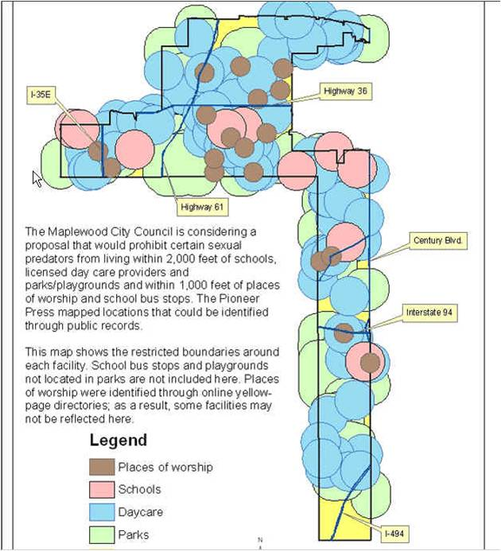

Data: collected either addresses or GIS maps with locations of schools, parks, daycares and places of worship
Notes:
Several years ago, a suburb of St. Paul was considering an ordinance that would’ve prohibited where certain sex offenders could live. The proposal called for banning them from living within 2,000 feet of daycares, schools, parks and playgrounds. And within 1,000 feet of places of worship and bus stops. We used various datasets to find the locations of these places in that city (we didn’t do bus stops or playgrounds) and then used GIS tools to analyze what portion of the city was left after the restrictions were applied. This map was the result – showing only two small sections of the city unaffected: one was an industrial park in the northern part of the city and the other was under a major interstate highway in the lower part of the city. The following week, the city council tabled the plan and hasn’t brought it back since.

Slide 27

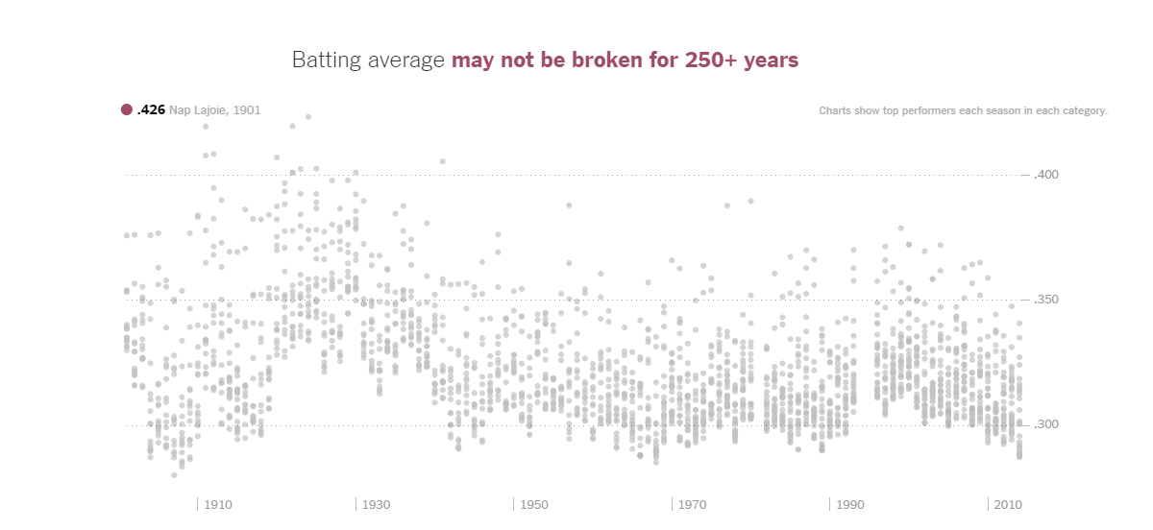
Notes:
By using something called extreme value theory — often used for modeling extreme weather events and floods — we can approximate how many seasons of baseball similar to the most recent era it would take for there to be a 50 percent chance that the single-season records below will have been broken.

Slide 28
I see data opportunities...everywhere

Slide 29
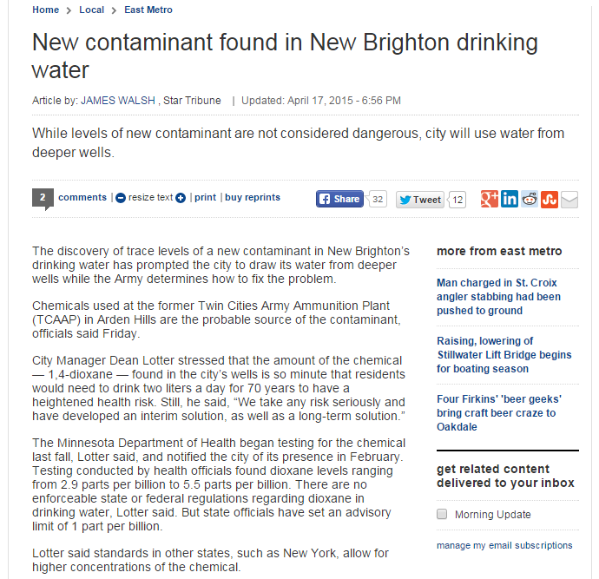
Does the Department of Health have a database of all its test results for all properties – including something that indicates contaminants found?
Where are they testing?
How often are they finding contaminants (and where)?

Slide 30
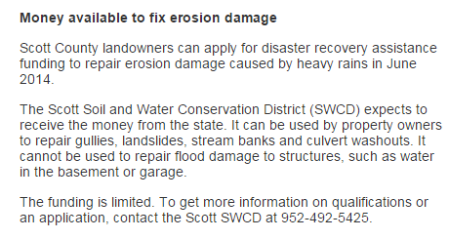
A year or two from now.... where did this money go?
Was it used the way it was supposed to?

Slide 31

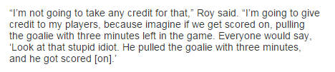
Notes:
Here’s an idea I’m stealing from C.J. Sinner.... she was watching the Wild play a few weeks ago and they pulled the goalie so they could have more shooters in the ice – a relatively common thing in the NHL -- but she wondered if we could analyze data to see how often that strategy works out. One of our stories, about a year ago, had this quote from Avalanche coach Patrick Roy – showing that it’s probably a really tough decision for coaches to make. It makes me wonder how often coaches end up as “that stupid idiot”, as Roy says, when they pull their goalie and then get scored on.

Slide 32
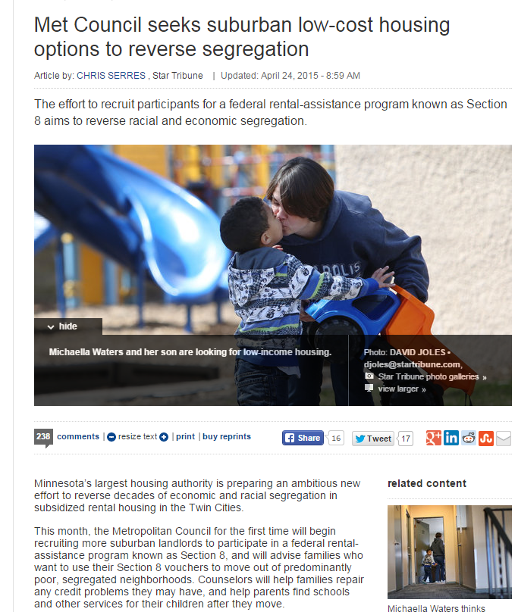
Now...let’s get more detail on this and set a baseline:
Met Council data show that about 25 percent of Section 8 voucher holders in the Twin Cities live in areas of moderate, high or very high poverty.
Later: Get the Section 8 data again and see what has changed

Slide 33
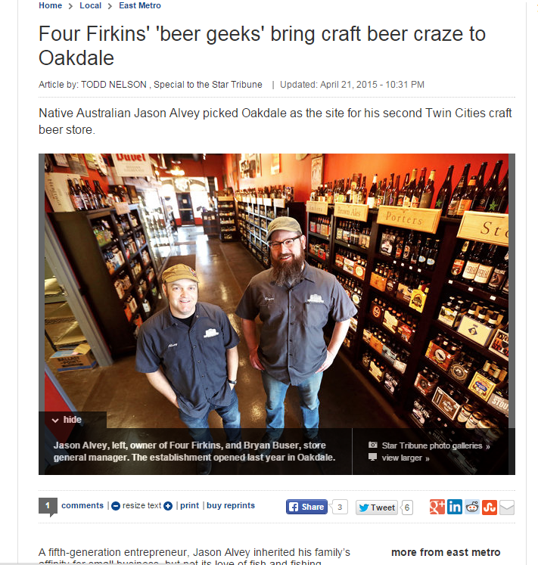
Can we quantify this “beer craze”?
Where are the new breweries?
Are they being inspected?

Slide 34
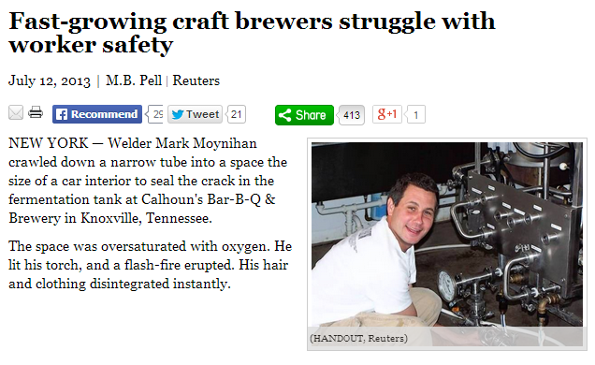
In fact, the inspection story has been done elsewhere.....

Slide 35
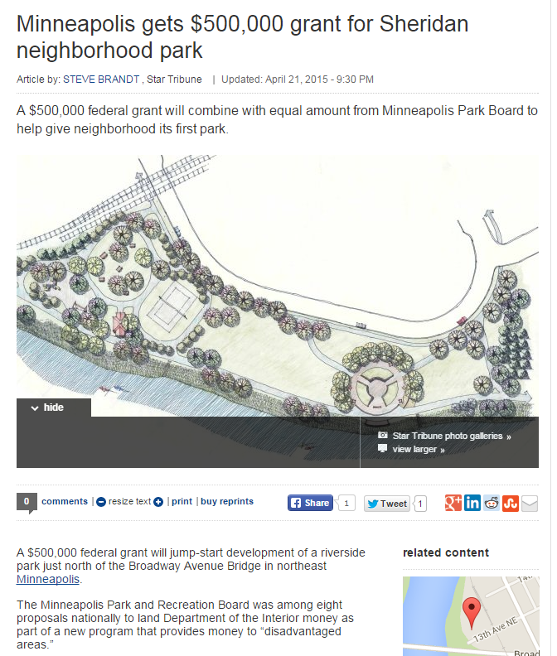
A year or two from now.... can we get detailed breakdown of how this money was spent?
What other federal grant dollars are flowing into Minnesota? And for what?

Slide 36
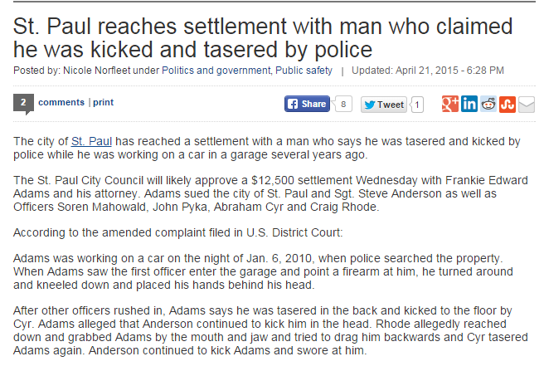
What other settlements has the city made in recent years?
For what? How much?
How does this one compare to the others?

Slide 37
What are some story ideas you have?

Slide 38
How to hone your data state of mind

Slide 39
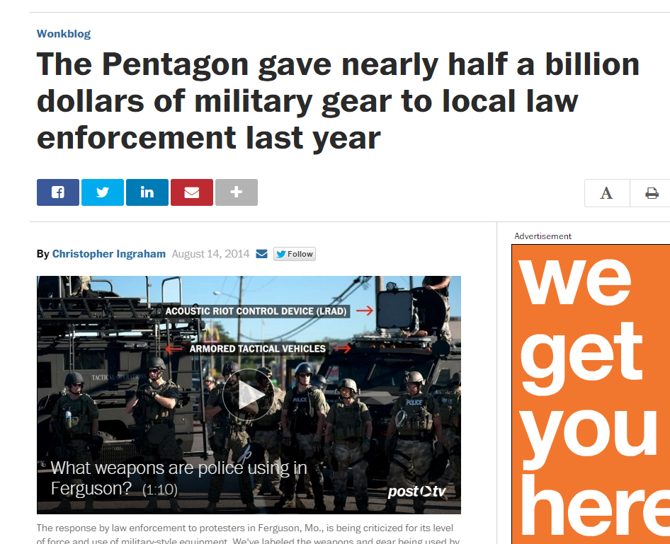
Find data sources on your beat
Take them “out for coffee”
Notes:
Last year, lots of news organizations got their hands on data about surplus military gear that the Pentagon had given to local law enforcement agencies. It was a hot issue in the midst of the chaos in Ferguson. What if the reporters in St. Louis had known about – and been familiar with – this data before the riots? That would’ve given them a head start.
Every beat has data of some sort. Some beats will be flooded with readily available data. Others will require putting in requests that take time. Others might have to build data from paper or multiple sources.
Regardless, take some time to figure out the key data sources on your beat. Just like you did with your human sources when you first got started. Get copies of some of the data, spend some time perusing it, asking it some questions and generally getting to know it. Once you have that tackled, it will be much, much easier to use the data in the midst of reporting a story – or under breaking news conditions.

Slide 40
Other things you can do...
Frame story ideas as questions, not nouns
Ask for underlying data when you encounter summary information
Think about whether summary data is enough? Does it provide the context you want?
Notes:
--frame story ideas as questions, not nouns
--when source quotes numbers to you or refers to numbers in a report – ask what the underlying data source is (and perhaps get a copy)
--improve how you go about asking for data (see more below) and what kind of data you get (raw versus aggregate)
--when asking your sources for information, think about whether the one or two numbers, or small chart, that they provided you is really enough. Does it provide the context?

Slide 41
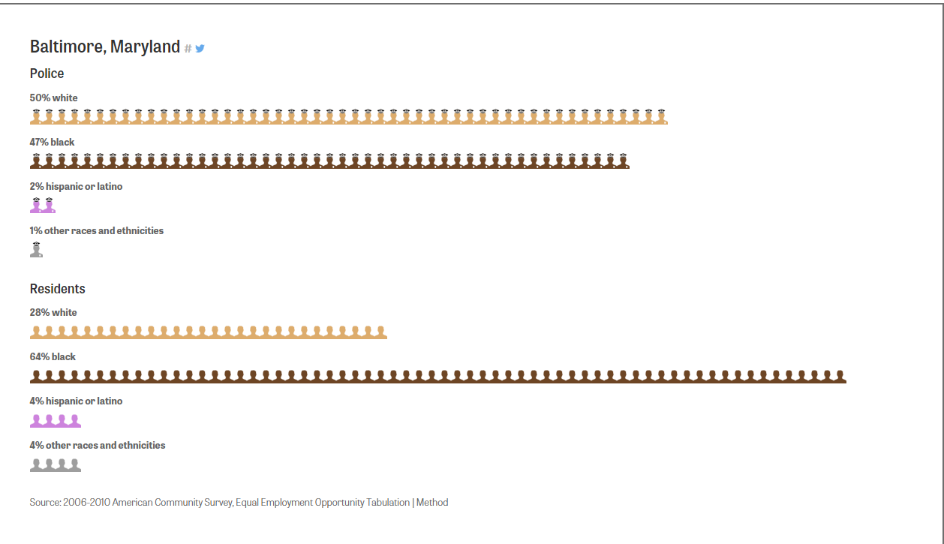
Notes:
We’re increasingly seeing presentations of summary data like this – this one is showing the racial makeup of Baltimore’s police department compared to the racial makeup of its residents.
This is very high-level data –but we need to also try to think below this high level. This one is kind of hard because we’d likely not be able to get detailed data on each individual officer – we’re kind of stuck with summary data. But what else could we find out if we dug a little deeper? Could we look at racial makeup of new officers, compared to older ones? Or the people who apply to the police academy? Can we find out the racial makeup at various points in time in the past and see how it has changed over time?
Think about the different variations that might exist out there before you start asking for data.

Slide 42
Finding ideas...
What did you write about a year or more ago?
What are the big trends on your beat. Have they been supported by thorough, unbiased analysis?
What are the “myths” on your beat?
Steal ideas: Follow IRE’s Extra! Extra!
Visualize your data
Notes:
-look back at stories you wrote 1, 2 or more years ago about initiatives that were launched – is there a way to use data to evaluate how they are doing?
--was there a change a year or more ago that you could measure using data? (example: a change in baseball rules intended to increase the number of homeruns – did it work?)
--what are the big trends on your beat? (what’s being talked about) Have they been supported by thorough, unbiased analysis?
--what “myth” stories exist on your beat. Can you bust them with data?
--visualize your data – some people have a hard time with rows and columns of data; and sometimes trends don’t make themselves obvious until you visualize it

Slide 43
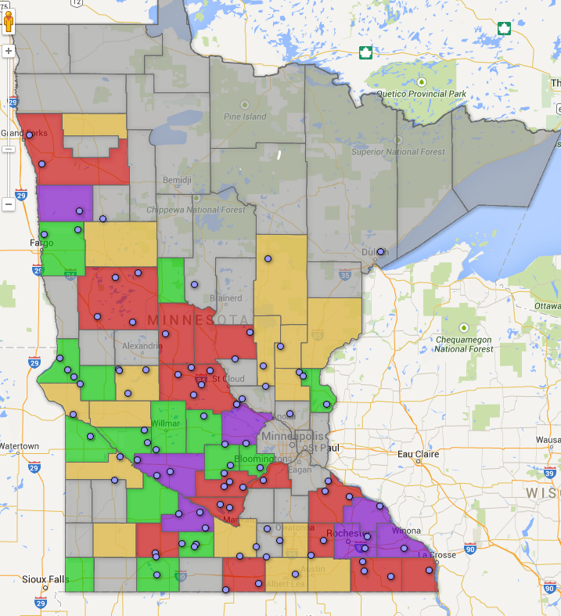
Google Fusion Tables
Notes:
Visualizing your data can also help you with the reporting – even if the visualization you make never gets published. This is a map Jeff Meitrodt made to help him figure out where to put boots on the ground for reporting his story on farm deaths. It shows the total number of deaths in each county over the last 10 years, then dots showing deaths in the last five years. I spent a couple hours showing him how to use this software – getting the data in, mapping it and then filtering it and changing the colors so he could ask it different questions.

Slide 44
Requesting data
Do some “reporting” or sleuthing about the data before making request. What’s in the data? What’s not?
Don’t ask for “lists” or “reports” – use terms like “machine readable” or “database-friendly format such as Excel or delimited text”
Don’t just ask for a few pieces of information. Think about context.
Notes:
When asking for data, try to think broader than just that one thing you think you want. For example, let’s say you want a dataset listing all the turkey farms in Minnesota and where they are located. That would mean that you’d want, at minimum, a turkey farm name and an address. So what can we do with that? We can map the locations and show where they are geographically. But that’s about it.
But what else does the agency collect about the turkey farms? Does it say how many barns? Does it give a “maximum” number of turkeys it could hold? Does it say anything about the size of the barns? Does it say when the farm was built or first registered with the state? Name of the company that owns it?
If we get some of the other things, we’ve got even more questions we can ask and more flexibility about what we can do with it.
The data you want might not exist in the exact FORM that you want. For example, Jeff Meitrodt wanted to find all ag-related deaths in Minnesota. He asked the state if they kept such as list or database. They said no. But then he realized that we have a database of every death in the state, with very detailed fields of information about causes of deaths and occupation of the decedent, even a narrative for some of them. Using the occupation and looking for keywords (like tractor) in the narrative field, he was able to pull together a list of deaths -- it’s possibly a little bit short, but it’s better than nothing.

Slide 45
Where can I find data?

Slide 46
EVERYWHERE!
Notes:
Keep in mind that most government agencies have a legal responsibility to track something or report to the legislature or Congress about something -- and they will most certainly use a database to do that. Lots of agencies have forms that they ask people to fill out – those usually go into databases. So once you get a sniff of something akin to data (a report, a form, some summary numbers), it’s just a matter of tracing it back to its origin in order to find the bigger database that you can do more with.
To prove to you just how pervasive data is, I asked my friends in the data journalism world to send me examples of datasets they’ve encountered that were completely unexpected. They gave me some interesting ones....

Slide 47
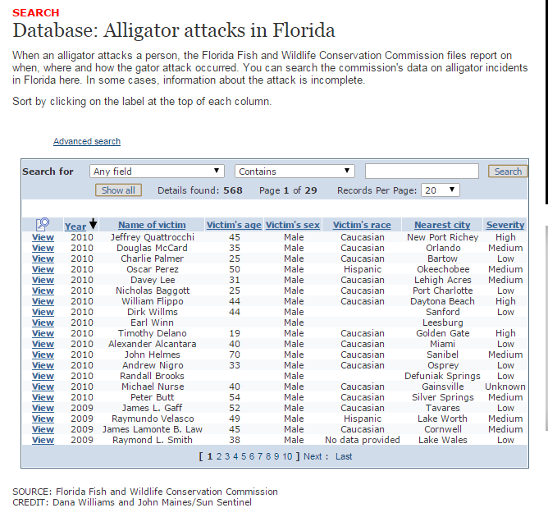
Notes:
Florida has a database of alligator attacks

Slide 48
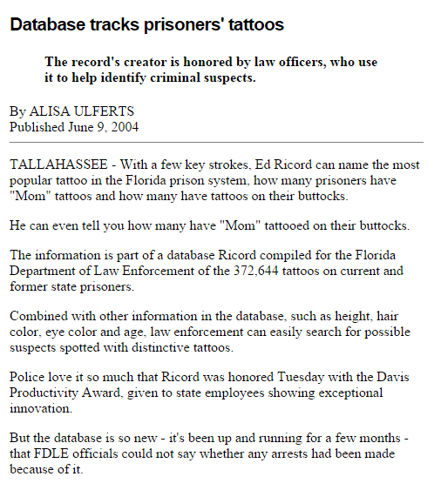
Notes:
The FBI has a database of prisoner tattoos

Slide 49
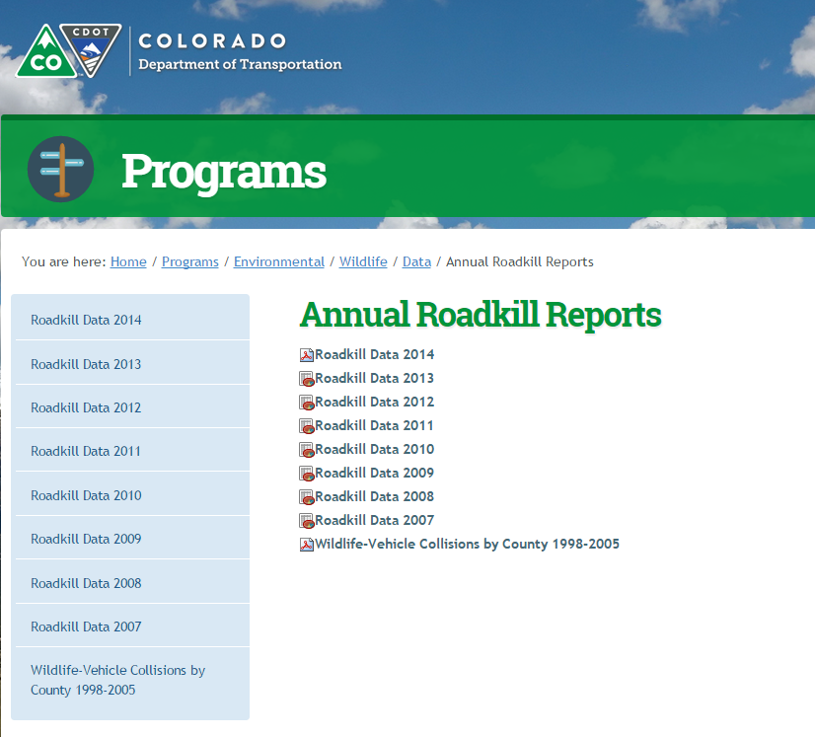
Notes:
Colorado has downloadable data files of roadkill.
A reporter in Washington state did a story from her state’s roadkill database

Slide 50
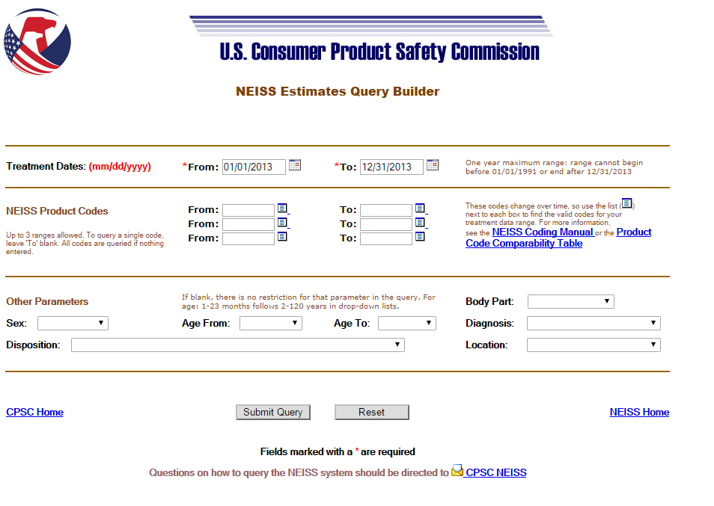
Injured while walking around, talking on cell phone
Notes:
this database has been used to find injuries caused by walking around looking at a cellphone, at least the ones that got people to an emergency room . You can pull up the code for phones and outdoors in public places (so you don't get people tripping over phone cords in their houses) and you might still have to look at each one to weed out things like having a phone booth fall on you (it happens)

Slide 51
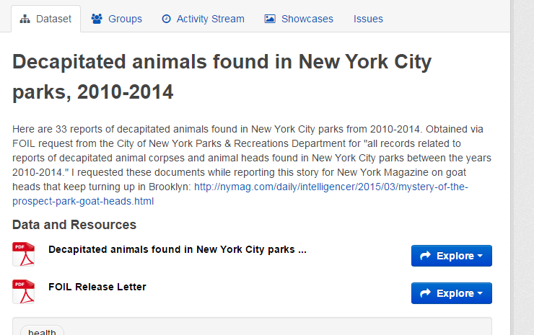
Notes:
NY’s data portal has a database of decapitated animals found in NY city parks.
Somebody else put together a map based on pigeon poop complaints in New York City.

Slide 52
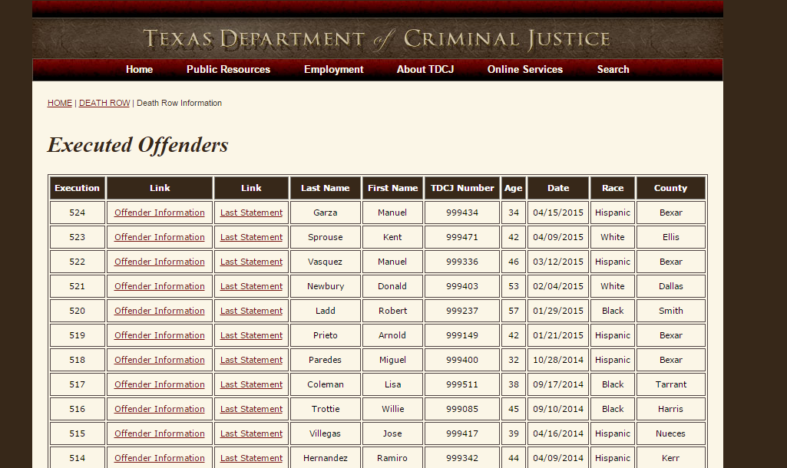
Notes:
A bit morbid but fascinating: Final statements of executed prisoners in Texas:
https://www.tdcj.state.tx.us/death_row/dr_executed_offenders.html
(caveat: they are not from recordings; they are written down by staff and not always verbatim)

Slide 53

Notes:
A TV reporter requested the US Fish & Wildlife’s Database of Seized Non-Live Animal Wildlife Products. They visited the storage facility where the seized items are held --- they saw purses made of bloated bullfrogs, corset made of caiman, the Alexander McQueen haute couture gown, a $2000 Dior reticulated python handbag, a $10,000 scarf made of Tibetan Antelope, the rhino horn, the tiger heads, the elephant tusks, dozens of bottles of pit viper wine (replete with fully intact viper staring at you from inside the bottle), a giant plastic bag of snake gall bladders (seriously) and, um, dried male tiger reproductive organs.

Slide 54
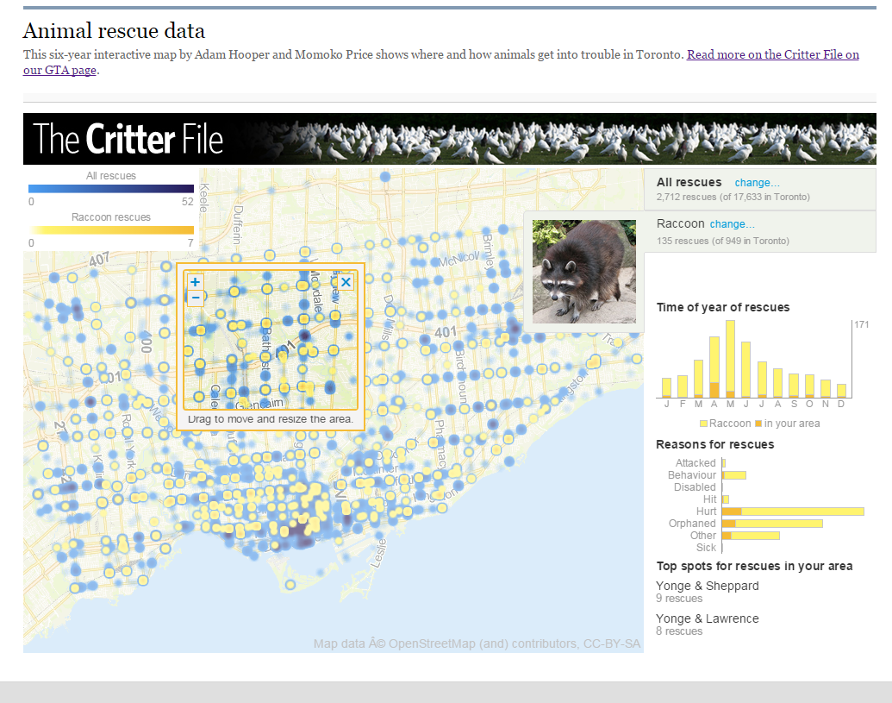
Notes:
Toronto Star regularly gets a database of rescued animals and they turned it into an online visualization.

Slide 55
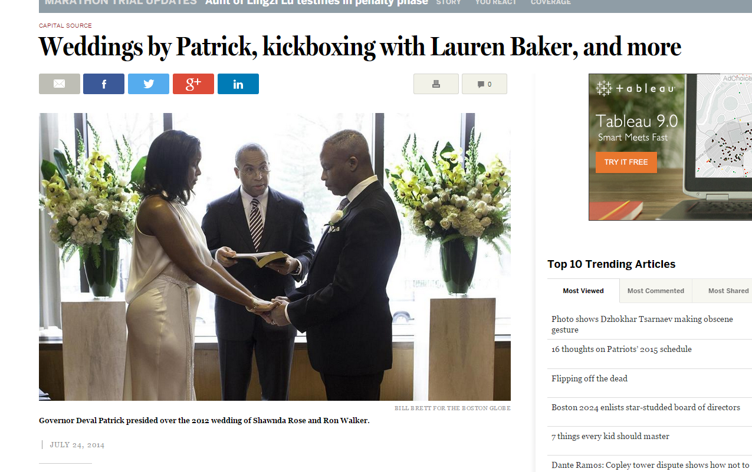
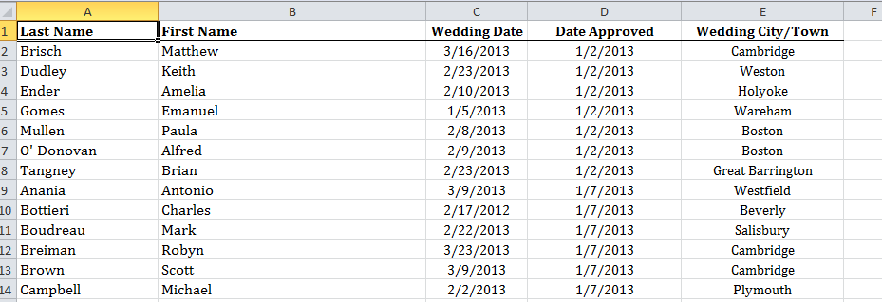
Notes:
Massachusetts has a database of all the people awarded one-day certificates to conduct a wedding.Muckrock got the 2013 list and put it online. https://www.muckrock.com/foi/massachusetts-1/one-day-marriage-designations-all-2013-10032/
Todd Wallack used the broader database to write a small item on all the marriages overseen by then Governor Deval Patrick:
http://www.bostonglobe.com/news/politics/2014/07/24/capitalsource/uFzAb6wjVI27eUftwVArqL/story.html

Slide 56
Some go-to data sites
University of Minnesota Office of Institutional Research
Minnesota Management and Budget
Minnesota Dept of Education
Minnesota Campaign Finance Board
MN Election results
MN Demographic Center
Met Council
Minneapolis data portal
Minnesota Geospatial Commons
CensusReporter
Census Bureau
Bureau of Labor Statistics
Fatal Analysis Reporting System
D.O.D. Military surplus data
NOAA Storm Events
National Center for Education Statistics
IPEDS (college data)
U.S. Dept of Agriculture
Notes:
We’ve reached a point where there’s so much data online now that I can no longer maintain a thorough list like this – places where I can download data. This is a very, very basic and incomplete list. If you come to me and ask where you can find data on a particular subject, it’s a crap-shoot as to whether I will know. Most likely I will give you advice on how to go about finding sites like this.
There are a couple key things:
Ask your human sources
Look at the methodology or footnotes of reports for names of databases or names of agencies that supplied data and then Google those names
Sometimes you can Google a term and tack on “.xls” or “.xlsx” to the search phrase to find spreadsheets that might have data you want. But I’m finding most agencies are storing their data in searchable databases that you can download from.
When you do find a web page with searchable data, look carefully for download options. They aren’t always obvious, but I’m finding it is usually there.

Slide 57
Other data to consider
Government contracts
Govt employee salaries
Other govt spending
Inspections (new construction, rental property, restaurants, kennels, nail salons, deli scales, gas pumps)
Fire department response times
Non-profit disclosures
311 calls
pot hole repairs
Executive salaries
Foreclosures & other property data
College athletics spending
Transportation – traffic volume, money spent on construction, public transit use, etc.

Slide 58
Tapping newsroom data resources
We don’t have enough bandwidth to do everything!
MaryJo and Jeff Hargarten will work as partners with reporters in producing any data-driven content.
Contact us as early in the process as possible! The day before/of publication is unacceptable unless it’s big breaking news and crucial that we use data.
Notes:
coming into this job, my marching orders are to help all corners of the newsroom do more and better data reporting. Since it’s impossible for me to do 10 things at the same time, that means I need to work hard at teaching everybody else to fish.
But there will certainly be situations where the analysis is too complicated or the story is too important and I will need to be involved in the gathering and analysis and reporting.
The same is true of Jeff Hargarten, who is our primary means of getting interactive data on the web.
Both Jeff and I would like to be partners with you. It will not work very well if you view us as a “service desk” that produces something and walks away. We should be involved in the process, from start to finish.
And since our resources are limited, it’s crucial that you contact us as early as possible – and also realize that we might not be able to help you. It’s all going to depend on what we have on our plates and the priority of your story against what we already have. It’s always worth asking us though.

Slide 59
Last thoughts...
Start small
Take my session on “Using numbers without fear”
“Data Literacy” book by David Herzog
“Computer-Assisted Reporting: A Practical Guide” by Brant Houston
Join #data channel on Slack
Learn how to “bulletproof” your data analysis. Guides are on my data training page: mjwebster.github.io/DataJ
Notes:
--start small – find a relatively straightforward story or two that you can do and get a success or two under your belt before trying something more complex
--if You haven’t done any data analysis and/or are not comfortable in Excel, start by pushing yourself to use more summary data. Instead of asking your sources for just one or two numbers, broaden it out to something more. Gradually move toward analysis of raw data
--Using numbers without fear class
--we’re expecting to do more training in summer (a little) and more in the fall, including more hands-on kinds of things in Excel, Tableau, maybe Access. Stay tuned.
--Data Literacy book or “computer-assisted reporting: a practical guide”
--Slack data channel
---bulletproof your analysis
--lots more training materials on my website

Slide 60
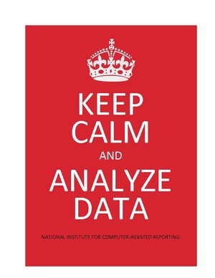
mjwebster.github.io/DataJ

